Slide 1
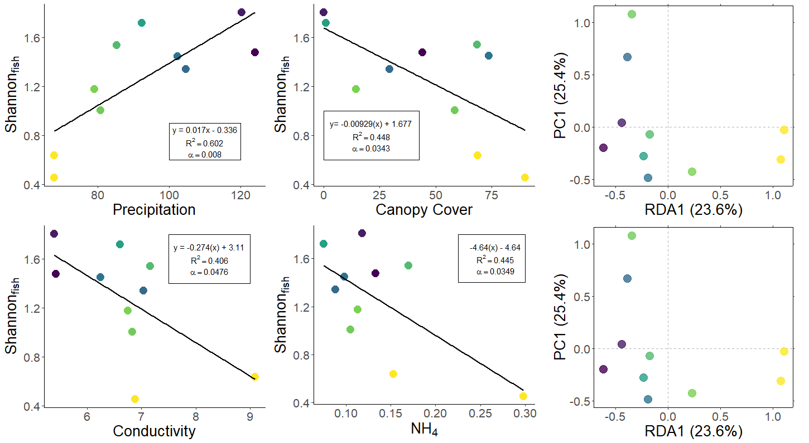
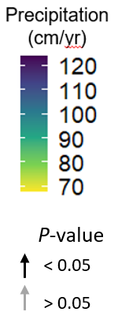
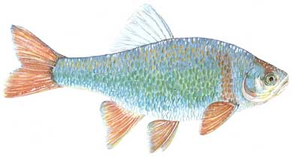
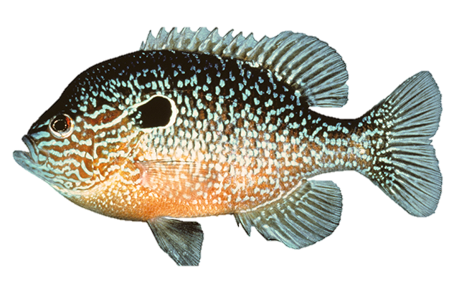
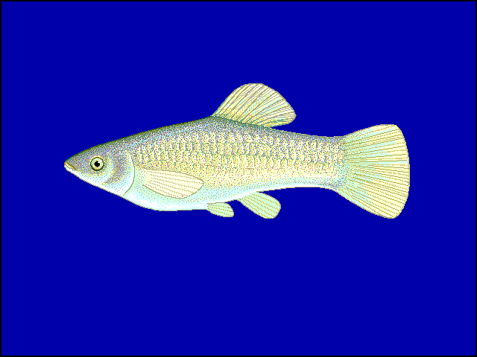
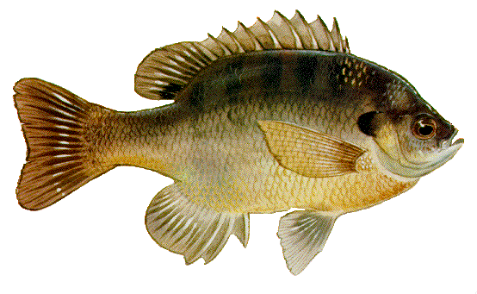
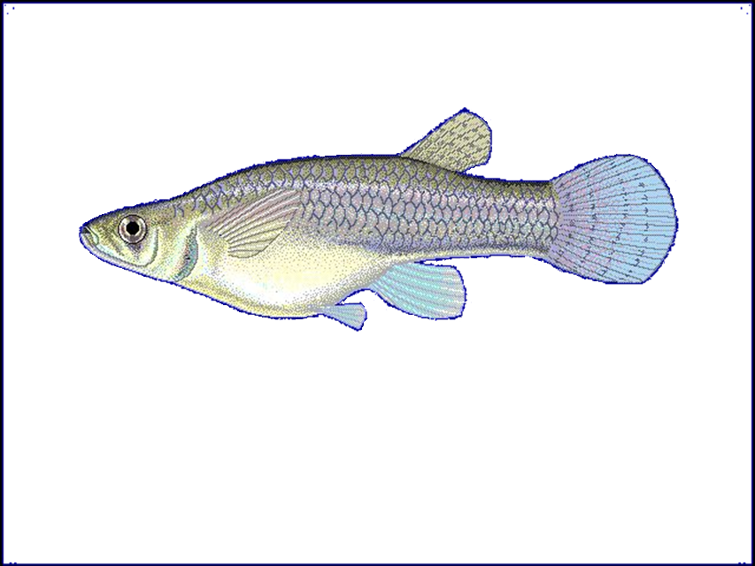
a
c
e
Flash Index
Conductivity
Canopy
Low Flow Pulse %
NH₄⁺
Precipitation
Rosgen Index
b
d
f
C. lutrensis
L. megalotis
P. latipinna
L. macrochirus
G. affinis
NH₄⁺
Notes:
Figure 3: Fish diversity plotted against (a) annual precipitation (cm/yr), (b) log-transformed conductivity (µS/cm), (c) canopy cover (%), (d) NH₄⁺ (mg/L). (E & F) Fish community ordinations using Hellinger transformation and redundancy analysis. Axes labels display the proportion of the variance explained as a percentage. Colored circles represent sites with color determined by annual precipitation. Arrows depict fitted vectors for (e) species and (f) environmental predictors which can be visually interpreted based on their direction. Black arrows indicate statistically significant (p-value < 0.05) correlations. Only significant species vectors were plotted to improve figure clarity.

